Slide 1
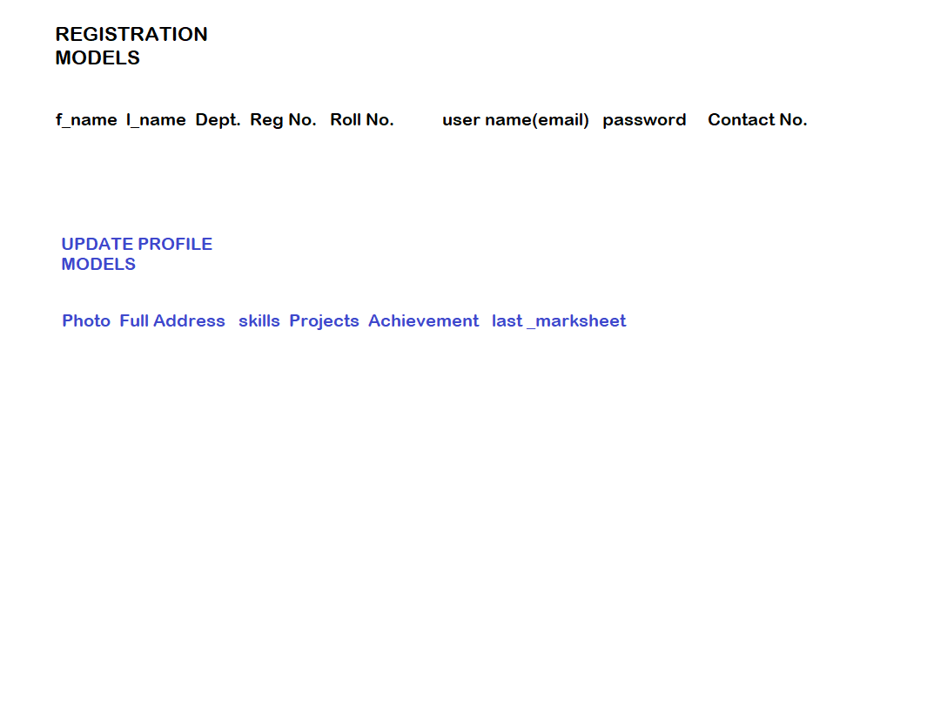
Update Profile page in student login portal

